Slide 1
RFID Based Security Systems
BHOJ KUMAR SANCHETI
BHARAT MANIKANTA
GOUTHAM SAI
MOHITA GUTTAPALLI
MANISHA SUNKARI

Slide 2
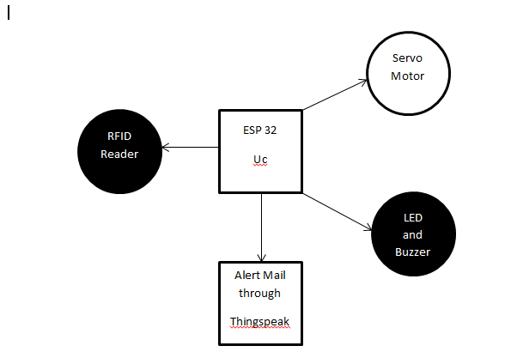
BLOCK DIAGRAM

Slide 3
COMPONENTS
ESP32
SERVO MOTOR
LED
BUZZER
RFID READER
BREAD BOARD
JUMPER WIRES

Slide 4
ALGORITHM
Step1: Include required libraries for WIFI , servo motor and ThingSpeak.
Step2: declare the global declarations and functions required.
Step3:In void setup() , write all the setup codes for the interfaced devices.
Step4: In void loop() , include the codes for the peripherals to run
Step5: Verify and upload the code.
Step6: verify output in serial monitor.

Slide 5
ABSTRACT
A radio-frequency identification (RFID) based access-control system allows only authorised people to enter a particular area of an establishment. Authorised people are provided with unique tags, using which they can access that area. This RFID based security system can be built on the micro controller ESP32 and comprises a RFID module, a Servo motor for authorizing access for entry , LED and buzzer to indicate unauthorized detection of the RFID card.

Slide 6
CURRENT APPLICATIONS
Automotive
Animal and Asset tracking (supply chains)
Currency Tracking
E-Passports & Immigration Tracking
FUTURE APPLICATIONS
Smart products
Smart Appliances

